Slide 1
Optimization of Reaction Conditions for Carboxymethyl Cellulose from Oil Palm Fronds
By: Joseph Cerafice
Report: Optimization of Reaction Conditions for Synthesis of Carboxymethyl Cellulose from Oil Palm Fronds, Penpun Tasaso, International Journal of Chemical Engineering and Applications, Vol. 6, No. 2, April 2015

Slide 2
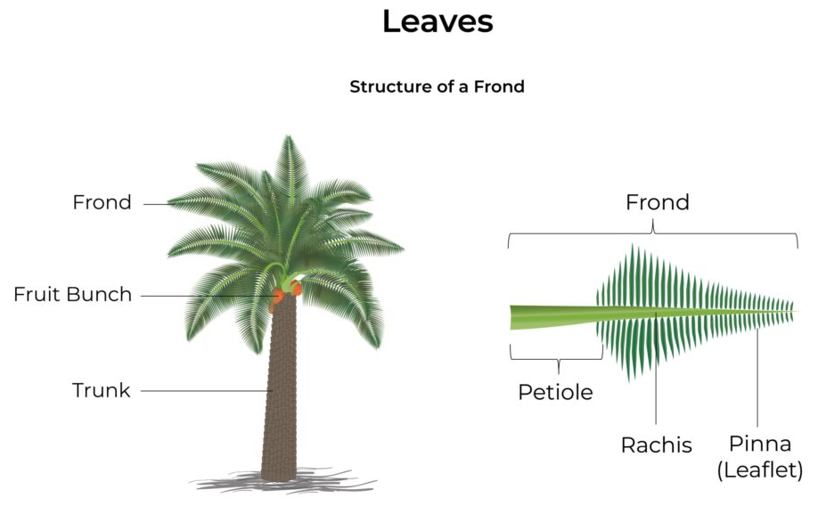
Introduction
Many forms of agricultural waste has been studied due to their potential economic and environmental benefits. In this case, oil palm fronds, a byproduct of the palm oil industry, have been explored for the synthesis of carboxymethyl cellulose (CMC). Oil palm fronds are abundantly available in regions like southern Thailand, making them a promising resource for sustainable material production. The conversion of oil palm fronds into CMC adds value to the waste material while also contributing to the development of eco-friendly and cost-effective products for various industries.
Notes:
Pic: https://www.musimmas.com/resources/blogs/oil-palm-anatomy-5-ways-an-oil-palm-differs-from-a-typical-tree/

Slide 3
Background
Cellulose, a natural polymer found in plant cell walls, serves as the raw material for the synthesis of CMC.
Process involves alkalization and etherification steps to introduce carboxymethyl groups onto the cellulose backbone, leading to the formation of CMC.
Etherification is a chemical reaction in which an alcohol, cellulose hydroxyl group, reacts with an alkyl halide or an alkene, monochloroacetic acid (MCA), in the presence of an acid catalyst, sodium hydroxide (NaOH), to form an ether. Alkalization refers to the process of increasing the pH level or alkalinity of a substance or solution.
The synthesis of CMC from oil palm fronds involves several critical parameters, including the concentration of NaOH, the amount of MCA, reaction time, and temperature. Optimization of these reaction conditions is essential to maximize the yield and purity of CMC.

Slide 4
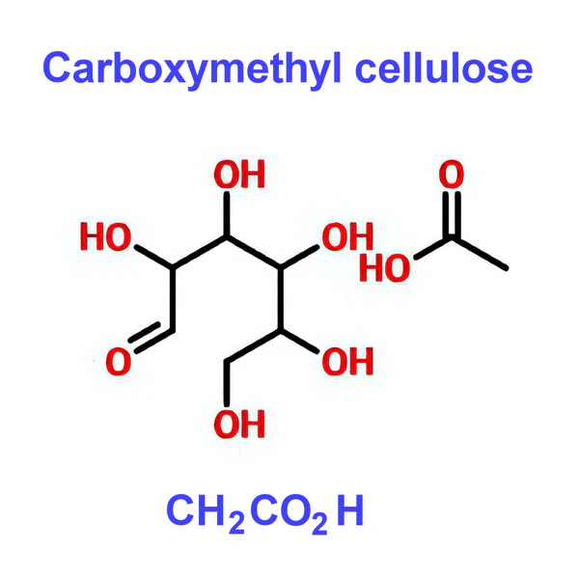
Applications of CMC
Carboxymethyl cellulose (CMC) is a versatile and widely used polymer with various applications in different industries:
Thickening Agent - used to thicken and stabilize food products like ice cream, salad dressings, and sauces.
Thickener also used in creams, lotions, and shampoos to adjust and maintain product viscosity.
Used to size yarns and fabrics to improve their strength and reduce fraying.

Slide 5
Problem/Goal
To optimize the synthesis of carboxymethyl cellulose (CMC) from oil palm fronds.
How? Optimize reaction conditions: % NaOH in mercerization process, (treatment of cellulose fibers with sodium hydroxide (NaOH) solution), weight of monochloroacetic acid in etherification process, to maximize % yield of synthesized CMC.
Degree of substitution - parameter that indicates the average number of carboxymethyl groups that have been introduced per anhydroglucose unit in the cellulose chain during the etherification process. Provides information about the extent of substitution of hydroxyl groups in the cellulose molecule with carboxymethyl groups, which directly influences the properties and functionality of the synthesized CMC

Slide 6
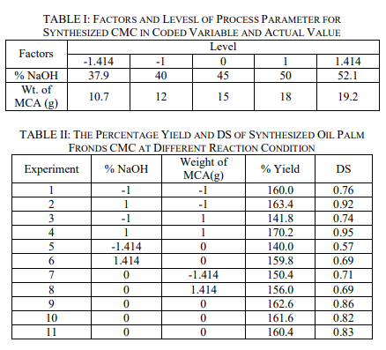
Approach
Make scatter plots of % NaOH & Weight of MCA(g) vs % Yield and DS Values
Find highest value of yield and DS and what reaction conditions corresponds to it.
Construct contour plots to observe trends between reaction conditions and yields.

Slide 7
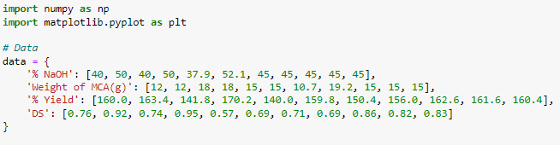
Code Implementation - Import/inputting data
Numpy - numerical computations
Matplotlib.pyplot - plotting library
A Dictionary “data” is defined with the experimental data with four keys: '% NaOH', 'Weight of MCA(g)', '% Yield', and 'DS'.

Slide 8
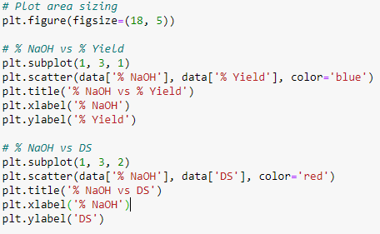

Code Implementation - Scatter Plots
Plt.figure - establishes the size of the area where the plots will appear for neatness
Plt.subplot - creates a subplot grid with 1 row, 3 columns
plt.scatter plots a scatter plot of % NaOH against % Yield in blue.
plt.title, plt.xlabel, and plt.ylabel set the title and axis labels.
Repeat process for NaOH vs DS, Weight of MCA vs % Yield, etc.
Subplot changes to identify each plot in their respective row/column.
automatically adjusts the positions of the axes on the figure to prevent overlap.

Slide 9
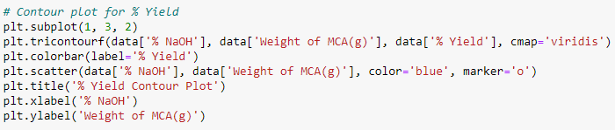
Code Implementation - Contour Plots
plt.tricontourf - creates a filled contour plot of '% Yield' against '% NaOH' and 'Weight of MCA(g)'.
Plt.colorbar - adds a colorbar to show the value scale.
Plt.scatter - overlays the data points on the contour plot.
Steps repeated for DS instead of Yield using different color map “plasma”.

Slide 10

Code Implementation - Printing Results
…
Finds the maximum values for % Yield and DS.
Prints out the highest % Yield and DS along with their corresponding % NaOH and Weight of MCA values.

Slide 11
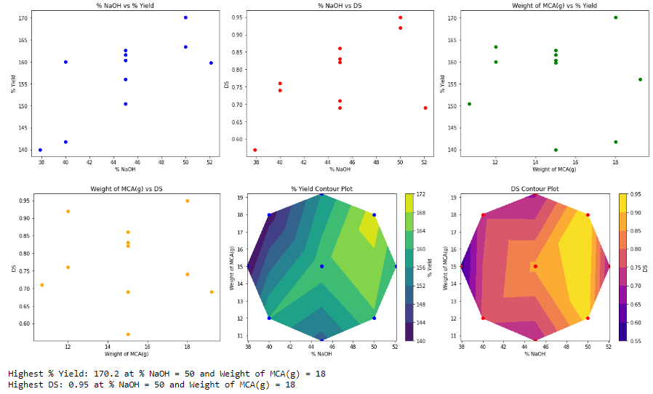

Slide 12
Analysis of Results - Scatter Plots
% NaOH vs % Yield - Data points are somewhat scattered. No definitive linear trend however there exists a range where Yield is typically higher.
% NaOH vs DS - Similar to % NaOH vs % Yield, a higher % NaOH tends to result in a higher DS.
Weight of MCA vs % Yield - no clear trend, data points are scattered without a clear pattern. Could only take highest yield and Weight value.
Weight of MCA vs DS - Similar to % yield plot, not definitive trend, could only take highest values.

Slide 13
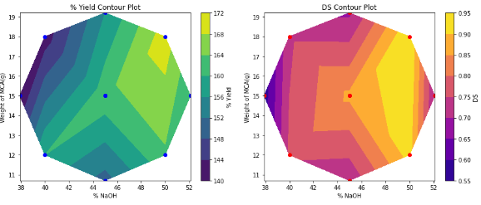
Analysis of Results - Contour Plots
% Yield Contour Plot - Yield reached a maximum with increasing NaOH & MCA. Top right of plot (yellow) indicates optimal values.
DS Contour Plot - Minimal correlation between weight of MCA and DS. Contour shows as the Y axis increases, color remains the same. NaOH % dominates change in DS as shown by bright yellow.

Slide 14
Conclusions
The highest Yield of 170.2% was achieved with %NaOH of 50% and a Weight of MCA(g) of 18g. Indicates that a higher concentration of NaOH and weight of MCA(g) are favorable for maximizing the % Yield of CMC.
The highest DS of 0.95 was obtained with % NaOH of 50 and a Weight of MCA(g) of 18. Also suggests that a higher concentration of NaOH and a higher weight of MCA(g)* are advantageous for achieving a higher DS, however, contour plots show NaOH mostly dominates DS.

Slide 15
References
[1] Optimization of Reaction Conditions for Synthesis of Carboxymethyl Cellulose from Oil Palm Fronds, Penpun Tasaso, International Journal of Chemical Engineering and Applications, Vol. 6, No. 2, April 2015
[2] https://www.musimmas.com/resources/blogs/oil-palm-anatomy-5-ways-an-oil-palm-differs-from-a-typical-tree/ - tree diagram
[3] https://matplotlib.org/stable/plot_types/unstructured/tricontourf.html - contour plot info\
[4] https://matplotlib.org/stable/api/matplotlib_configuration_api.html#matplotlib - matplotlib info
[5] https://matplotlib.org/stable/gallery/mplot3d/mixed_subplots.html - plot figure sizing
[6]https://matplotlib.org/stable/api/_as_gen/matplotlib.pyplot.tight_layout.html - tight layout
[7] https://www.capecrystalbrands.com/blogs/cape-crystal-brands/understand-carboxymethyl-cellulose-in-food-and-its-benefits - CMC chemistry

